Slide 1
General Guidelines for Presentation
Slides should not be too heavy with content. Better to create point wise.
If you require more than one slide for any point, right click on that point slide then select duplicate slide and modify the duplicated slide.
Diagrams must be aligned at centre and clearly visible with caption.
All the mentioned fonts, font size, title content, etc should not change and strictly as per the given format and guidelines.
Notes:
1

Slide 2

ML Based Comprehensive Application For Enhancement Soft Skills
Group No. 10
Sourav Joshi 19104068
Akshay Bura 19104041
Sakshi Deshpande 19104002
Prof.Rujata Chaudhari
Notes:
2

Slide 3
Contents
Abstract
Introduction
Objectives
Literature Survey
Problem Definition
Technological Stack
Proposed System Architecture/Prototype
Notes:
3

Slide 4
1. Abstract
Now a days most of the students are facing problem to talk in mob or having lack of confidence even though they knew many more things but cannot express it because of lack of confidence. To address this problem we are building an cross platform application through which students can improve their soft skills and build confidence to express themselves. Many people treat social anxiety like a disease which never going to cure and they will remain like this for the rest of their life ,but that is not true. In this project we are creating an application which will be helping in boosting the self confidence of students by exploring state of the art models to extract emotions and body postures which will help in building confidence
Notes:
4

Slide 5
2. Introduction
Many students has a lack confidence and verbal inability in social environment like placement drives and that may affect their job interviews.
There are abundant of sources and mediums to detect lack of self-confidence but most of them don’t help in building confidence.
Since we will be automating ‘Xpression Club’ activity which was introduced by our organization.
We are providing a platform where all these problems can be solved.
Notes:
5

Slide 6
3. Objectives
To automate Xpression Club (Xpression Club is an initiative which was introduced by our organisation to boost the confidence level of students).
To Improve logical thinking and verbal ability of the students.
To predict the confidence level of students and help them in improve it.
To create an user friendly UI using flutter.
To perform feature extraction on the video using mediapipe.
To Predict the confidence in speech using NLP.
Notes:
6

Slide 7
4. Literature Survey
Sr. No. | Research Papers | Findings | Using these findings for-
1. | Multimodal Emotion Recognition | Here they are providing definitions of affective computing and multimodal sentiment analysis. | Video and audio analysis
2. | Facial Emotion Recognition Using Machine Learning | This paper compares CNN and SVM | From this comparison we have found CNN is most appropriate algorithm for our application.
Notes:
7

Slide 8
Sr. No. | Research Papers | Findings | Using these findings for-
3. | pWAVE : A Novel Dataset For Emotional Confidence Detection | A novel hand-labeled dataset is used for learning emotional confidence detection. | analysis of the confidence using audio pipeline

Slide 9
5. Problem Definition
Problem Identified :
Due to lack of confidence, user may need a personal mentor to guide them, track down their progress, and solve their problems.
Also, students don’t get enough mental attention, so they become anxious and don’t talk with other people due to anxiety and low self-esteem.
Solution Proposed :
Our Application provide a solution to anxiety and verbal ability. This app provides all the features free of cost.
We will be using Convolutional Neural Network (CNN) algorithm to predict the confidence of the person. We are getting good accuracy using CNN algorithm..
Notes:
9

Slide 10
6. Technology Stack
Front End
Flutter 3.3.2
Dart 2.18.1
Back End
AI / ML
MediaPipe - To Identify the Posture
NLP - To Predict the confidence in speech
Cloud (AWS) - To store video and data from app
Notes:
10

Slide 11
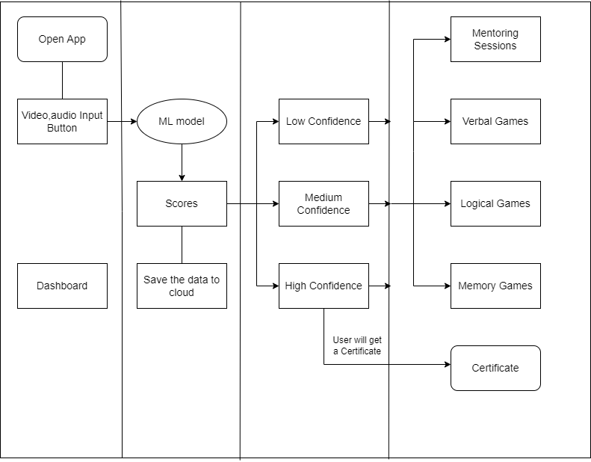
7. Proposed System Architecture/Prototype
Design/Structure Of Application
Notes:
11

Slide 12
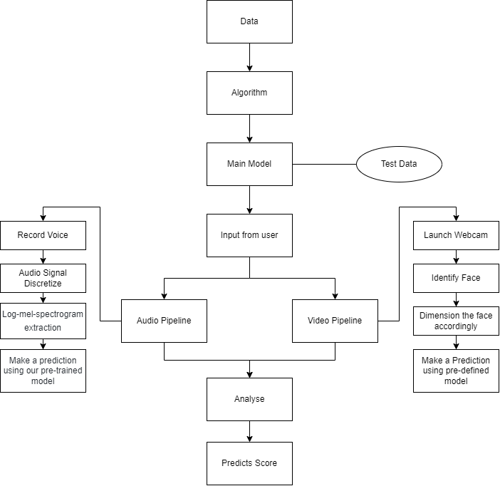
ML Model
Notes:
12

Slide 13
References
Multimodal Emotion Recognition 2019
Facial Emotion Recognition Using Machine Learning.
ADAM- Anxiety Detection and Management: a Solution to Manage Anxiety at Workplaces and Improve Productivity.
A Chatbot for Changing Lifestyle in Education.
Notes:
13

Slide 14
7. Suggestions Given During Review 1
In abstract, Sentence framing was required.
Need to elaborate project concept in detail with proper sentence formation.
Problem definition should be short.
Working model should be self-explainatory.

Slide 15
Thank You...!!
Notes:
15

